Slide 1



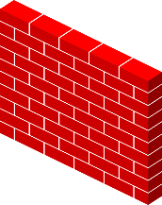


2.1 High level component and their interactions
Server
Client
Firewall
Firewall
Network
Mobile Interface
Database Server
Travlendar+ DB
Application Logic

Slide 2
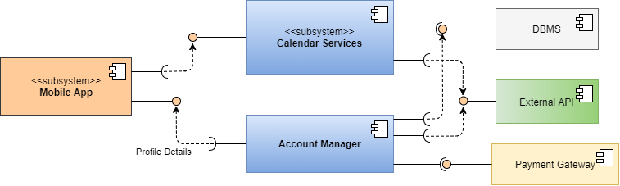
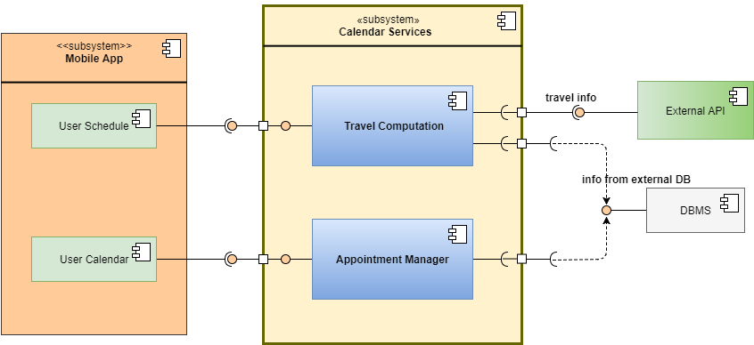
2.2 Component view

Slide 3



2.6 Architectural styles and patterns
Architectural style:
3-tier Client-Server
Data
Client
Server
Database
Server
Dbms
Mobile Interface
Network
Application
Server
Network
Travlendar+ DB
Travlendar+ application is based on a 3-tier architecture: Presentation, Application and Data. Presentation deals the
User interface and all things regarding the interaction with the user; Application is placed in a server and deals all logic
Operation about all functionalities; at last Data is external respect both the presentation and the application and contains
All data the application needed to compute all functionalities.
We provide a client-server model: Client develops mobile interface and then there are two server, application server and
Data server, which comunicate throught network infact they are different server.

Slide 4
2.6 Architectural styles and patterns
Patterns:
State pattern: appointments can assume different state, depending on
time or concurrency situation. Possible state are:
unreacheable, overlapped and
past, present or future.
Model-view-controller: usefull to manage interaction between client and
application server.
Observer pattern: permits to comunicate in a simple way beetwen server
and client, for example to manage notifications

